Slide 1


Costly Search and Mutual Fund Flows
Journal of Finance | 1998

Slide 2
Costly Flowchart
WSU
Structure
Section I
Describes the data and reports on consumers’ sensitivity to fund performance and expenses (ignoring costly searches)
Section II
Describes how costly search might affect the growth of different funds, testing these predictions.
Section III
Describes implications for mutual fund management and a brief conclusion.

Slide 3


Mutual Fund Marketing
WSU
Marketing
The average mutual fund account size is approximately of the same magnitude as the price of new cars purchased by U.S. consumers.
In both cases, consumers must choose from a large number of alternatives – “brand” plays a huge roll
“Value” is difficult to determine
Other things may influence (e.g., consumer satisfaction), but branding reigns superior throughout industries (Sheena C. Howard, Ph.D. for academics)
Consumers’ purchasing decisions… are complicated by costly search.

Slide 4
Situational Setup
WSU
Literature
“As a starting point, we consider mutual fund purchases in a world in which consumers can obtain and process information about mutual funds at zero cost.”
Consumer only have information about past net performance (return, risk, and fees) – does this historical information predict future returns?
Academic literature suggests:
Persistence in fund returns is observable among the lowest performing funds – poor performers repeat (Hendricks et al., 1993; Carhart, 1997)
Mixed support suggests the persistence among high performers (Hendricks et al., 1993)
Repeated winners are often attributed to survivorship biases (Brown and Goetzmann, 1995)
Generally, though not consistently, research shows that higher-fee funds do not perform as well as lower fee funds (Elton et al., 1993)

Slide 5
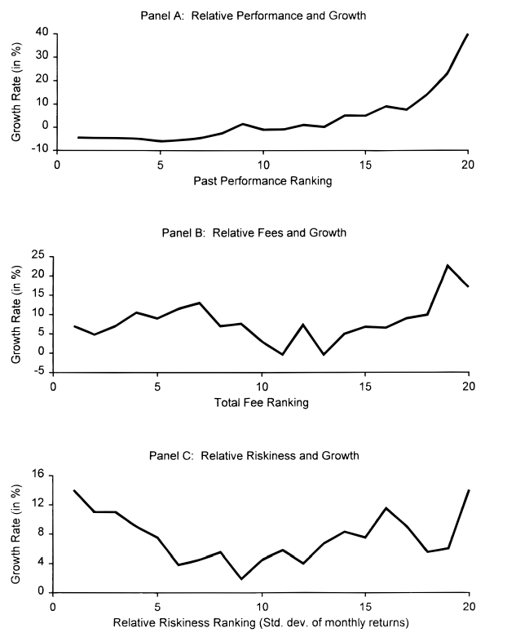
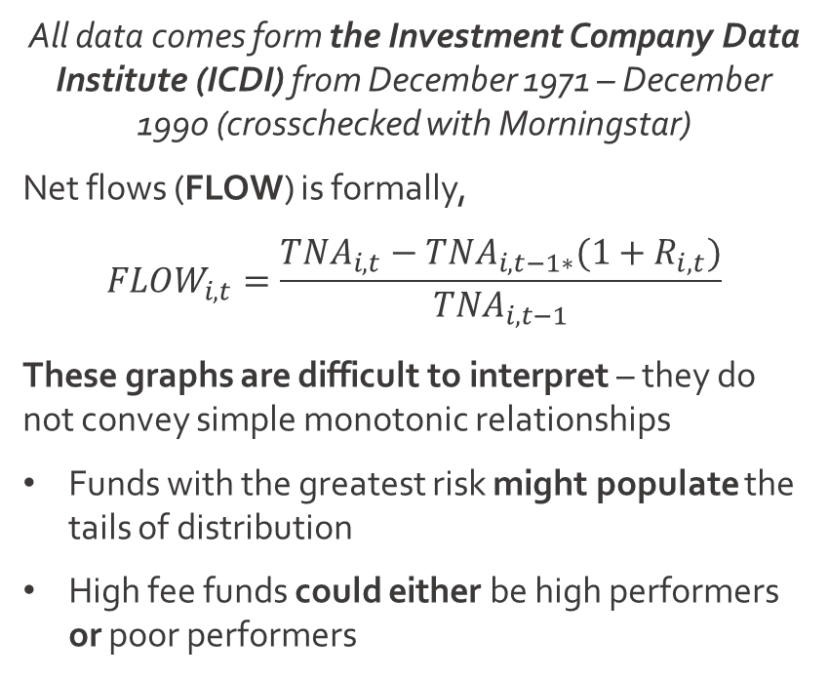
Empirical Setup
WSU
Data
All data comes form the Investment Company Data Institute (ICDI) from December 1971 – December 1990 (crosschecked with Morningstar)
Net flows (FLOW) is formally,
$${FLOW}_{i,t}=\frac{{TNA}_{i,t}−{TNA}_{i,t−1∗}(1+R_{i,t})}{{TNA}_{i,t−1}}$$
These graphs are difficult to interpret – they do not convey simple monotonic relationships
Funds with the greatest risk might populate the tails of distribution
High fee funds could either be high performers or poor performers

Slide 6
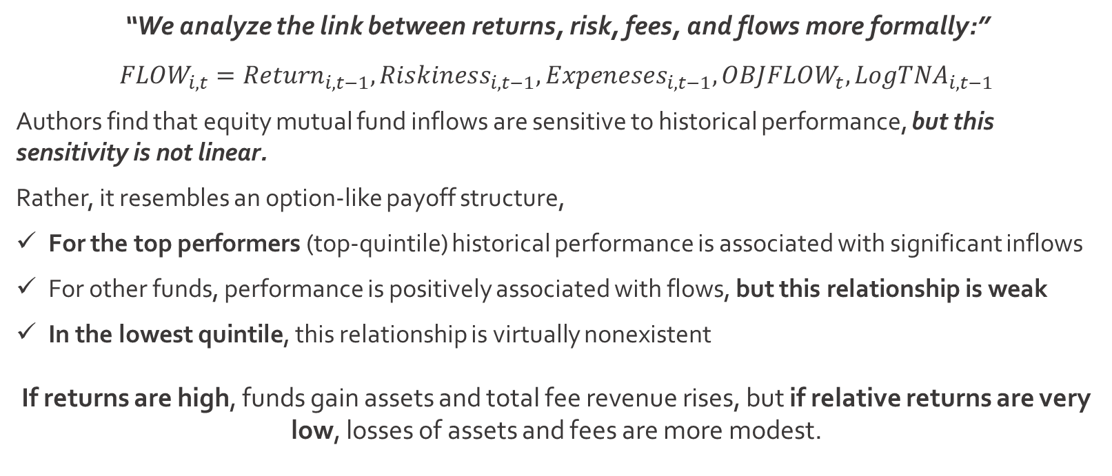
Empirical Setup
WSU
Data
“We analyze the link between returns, risk, fees, and flows more formally:”
$${FLOW}_{i,t}={Return}_{i,t−1},{Riskiness}_{i,t−1},{Expeneses}_{i,t−1}, OBJ{FLOW}_{t}, {LogTNA}_{i,t−1}$$
Authors find that equity mutual fund inflows are sensitive to historical performance, but this sensitivity is not linear.
Rather, it resembles an option-like payoff structure,
For the top performers (top-quintile) historical performance is associated with significant inflows
For other funds, performance is positively associated with flows, but this relationship is weak
In the lowest quintile, this relationship is virtually nonexistent
If returns are high, funds gain assets and total fee revenue rises, but if relative returns are very low, losses of assets and fees are more modest.

Slide 7
Survivorship Bias
WSU
Results
If poor performing funds shrink and cease to be sold, wouldn’t this sample only include funds that survive?
Authors estimate the sample from 1987 – 1990:
This allows authors to test whether lack of performance-flow link among poor performers is due to survivorship bias
Authors continue to find qualitatively similar results
The absence of a strong link between performance and flows for the poorest performers is not attributable to survivorship bias
Now, these specifications (no fee changes) show that funds with higher fees tend to grow more slowly than funds with lower fees

Slide 8
Fees & Flows
WSU
Costs
How are flows affected when funds alter their fees?
We expect rational investors would react strongly to fee changes:
Authors examine how search costs impact how consumers process information about performance, fees, and other fund characteristics
Funds that increase total fees by one standard deviation (1.74% - 2.41%), flows would drop from the mean of 11.4% to 3.0% (presumed symmetric)
As fees are lowered, the flows increase (a 20 basis-point decrease in fees results in flows that are 4.2% higher)
The introductory and stylized model fails to capture important aspects of consumers’ buying process
“Once we acknowledge that collecting and processing information are costly activities, we predict that consumers would purchase those funds that are easier or less costly for them to identify.”

Slide 9
Costly Searches
WSU
Costs
Authors must construct meaningful measures of search costs and marketing efforts:
Mutual Fund Complex Size
LogTNA under management – simply size
Authors aim to test whether funds in larger complexes grow faster and can better capitalize on high performance
(No greater performance-flow relationship, but some across-the-board flow benefits)
Marketing and Distribution Expenditures
Both marketing and selling are costly activities (supported by front-end loads, 12b-1 fees, and back-end loads)
Somewhat counterintuitively, these increases in fees support a reduced search cost for consumers
(A strong relationship between fees and performance-sensitivity)
Media Coverage
Authors aggregated a database of media citations of individual funds in major newspapers and periodicals
They posit that funds receiving greater media attention will grow faster, having a stronger performance-flow relationship
(Media has a short shelf-life)

Slide 10
Spillover Effects
WSU
Costs
“We consider whether a fund family is able to lower search costs for a particular fund by enjoying ‘halo effects’ from funds in the complex that performed well.”
(This is somewhat related to the media effect)
T. Rowe Price
New Horizons (t-1)
New Horizons
New Era Fund
New Income Fund
New Asia Fund
Testing this empirically:
Other things equal, a 4% additional flow would go to a mutual fund that was member of a fund family that had a “stellar-performing” offering in another objective category
This is not robust across specifications
In part, it appears the spillover variable is serving as a proxy for fund complex size

Slide 11



Implications & Conclusions
WSU
“To the extent that mutual fund investors succeed as active managers, part of the credit must go to marketing, which seems related to the pronounced performance-flow sensitivity of consumers.”
Higher fees → stronger performance-flow
More media → faster current growth
Funds are typically part of a larger complex
In many ways, this article foreshadowed future research done on investor behavior and mutual fund industry structure.

Slide 12
Tournaments and Temptations: An Analysis of Managerial Incentives in the Mutual Fund Industry
Journal of Finance | 1996

Slide 13

An Alma Mater Example
WSU
Tournaments
“Similar to the payoffs for golf and tennis competitions, the amount of remuneration that a fund receives for ‘winning’ this tournament depends upon its performance relative to the other participants.”
“The Zags have spawned a transformation of a tiny, struggling college into a national brand and money magnet.”
Jody Lawrence-Turner (Spokesman, 2017)
Since the Cinderella Story (the ‘Flutie Effect’):
Total university enrollment has nearly 4x
University endowment > 3x; (2017 $250M funding campaign)
Hemmingson Center ($60M), Myrtle Woldson ($37.5M), McCarthey Center ($25M)
SBA Expansion, UW Medical Center, Student Housing, Paccar Expansion

Slide 14
People Like Winners
WSU
Tournaments
Especially when it comes to their money.
“In this paper we argue that even without incentive fee contracts, the competitive nature of the mutual fund environment alone can affect a manager’s portfolio decision.”
Attractive situation – less absenteeism or tardiness in successful organizations
Solid support system – winning enlarges a circle of backers
Better press – it’s not just buzz, it’s more favorable stories
Self-determination – winners have more control over their own destiny
Continuity – Lose too often, and heads roll (new coaches, new strategies)
- Rosabeth Kanter (HBR, “Ten Reasons Winners Keep Winning, Aside from Skill”)
Authors conjecture that the set of funds most likely to be “losers” in the final tournament results will see their risk levels increase relative to the group of probable “winners.”

Slide 15
Competition, Not Finances
WSU
Tournaments
The market for portfolio management services, and mutual funds in particular, can be viewed as a multi-period, multigame tournament:
Business publications and information services (e.g., Business Week, Barron’s, Forbes, Money, Morningstar Mutual Fund Services, etc.) regularly rank funds according to their return performance (annually, quarterly)
Sirri and Tufano (1992) find that investors respond to these rankings, flows of new capital are related to their performance. Mutual funds ranking the highest receive the larger share of new investment inflows
If managers view themselves as being participants in a series of tournaments in which their funds are continually ranked, their behavior should show certain systematic, measurable tendencies
Consequently, decisions made by fund managers are predicted on a call option-like payoff structure, influenced by performance ranking

Slide 16

The Economics of Tournaments
WSU
Marketing
“In fact, many compensations and reward structures can be viewed as tournaments.”
(1) Agency Theoretic Contracting
(2) Normative Aspects of Performance-based Compensation Schemes

Slide 17
Empirical Setup
WSU
Data
“The data for this paper consist of monthly returns to 334 growth-oriented mutual funds followed by Morningstar Mutual Fund Services and contained in their database.”
Between 1976 and 1991, the total number of funds grew 3x (1/2 of this in the last 5 years of the sample)
The total dollar amount invested (year-end) grew from $8.93B to $134.24B
Subgroups are created of interim winners and losers according to a fund’s relative return performance between January and month, M for each fund, j, in a given year, y
Authors then calculate the M-month cumulative returns
Then, authors construct a variable of fund volatility measured before and after the interim assessment period

Slide 18
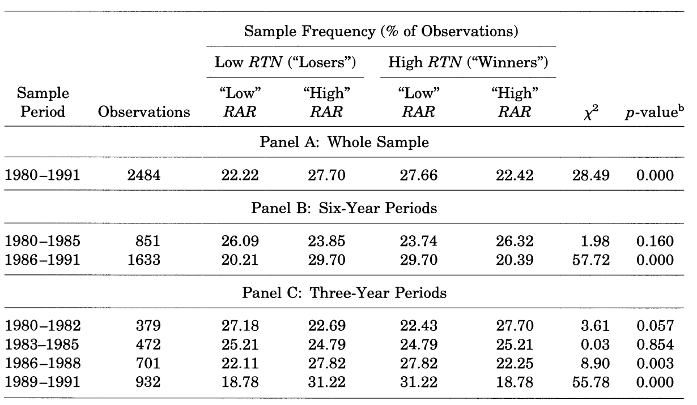
Basic Findings
WSU
Data
While every interim assessment month appears significant, it is clear that July marking date (M=7) is associated with the largest divergence (greatest change in fund volatility).
Interestingly enough, this trend is increasing.

Slide 19
Changes in Portfolio Risk
WSU
Results
Another interesting issue to consider is the way in which managers affect these changes (lower return funds altering portfolio risk to a greater degree).
Generally speaking, there are two possibilities:
The first (implicit in the tournament storyline) is that managers actively revise the composition of their portfolios to achieve an explicitly riskier profile (completely turning over existing security holdings or altering the entire fund synthetically with derivative positions)
The second (more reactive) implies that management continues to hold the same portfolio after the assessment date but the securities in that portfolio are now riskier than before.
Active Management
Apathetic Management
Control groups find qualitatively similar and significant results.

Slide 20
Implications
WSU
SUBTITLE
“In this paper we argue that the mutual fund industry is appropriately viewed as a tournament in which the funds compete with one another for new assets based on their relative performance.”
It is expected that interim losers would increase the risk of their funds more than would interim winners
This effect is most pronounced in the last six years of the sample, with an increasing trend
It is possible that the current tournament structure of the mutual fund industry does provide adverse incentives to fund managers

